Slide 1
System Design (1)
Design chat system
Facebook message/whatsapp/signal
你们的好朋友Eddie

Slide 2
Normal steps of system design
Requirement clarification
Scale of the system - data size
API interface
Database data-model
High-level design(draw a picture)
Detailed design(corner case of user user case, cache, load balance, optimize)
Bottlenecks (single point of failure, replicas of the data if lost, monitoring, alart, autofix/ticket)

Slide 3
Difference between facebook message/whatsapp
 | Facebook Message | Whatsapp / Signal
store data | permanent (In server forever) | temporary (Delete after user receive it, not exist after user delete app)
encryption | If they wish, they can read message in the middle server if you didn’t turn on encryption | End to end encryption, middle tier/service can not read the message

Slide 4
Step 1: Requirements clarifications (ask questions about what use case they want)
Base function:
One to one chatting message(sent/delivered/read)
user (online/offline-Last seen time)
Picture, video sharing in the message
Extend function:
Group Chats: Messenger should support multiple people talking to each other in a group.
Push notifications for offline user

Slide 5
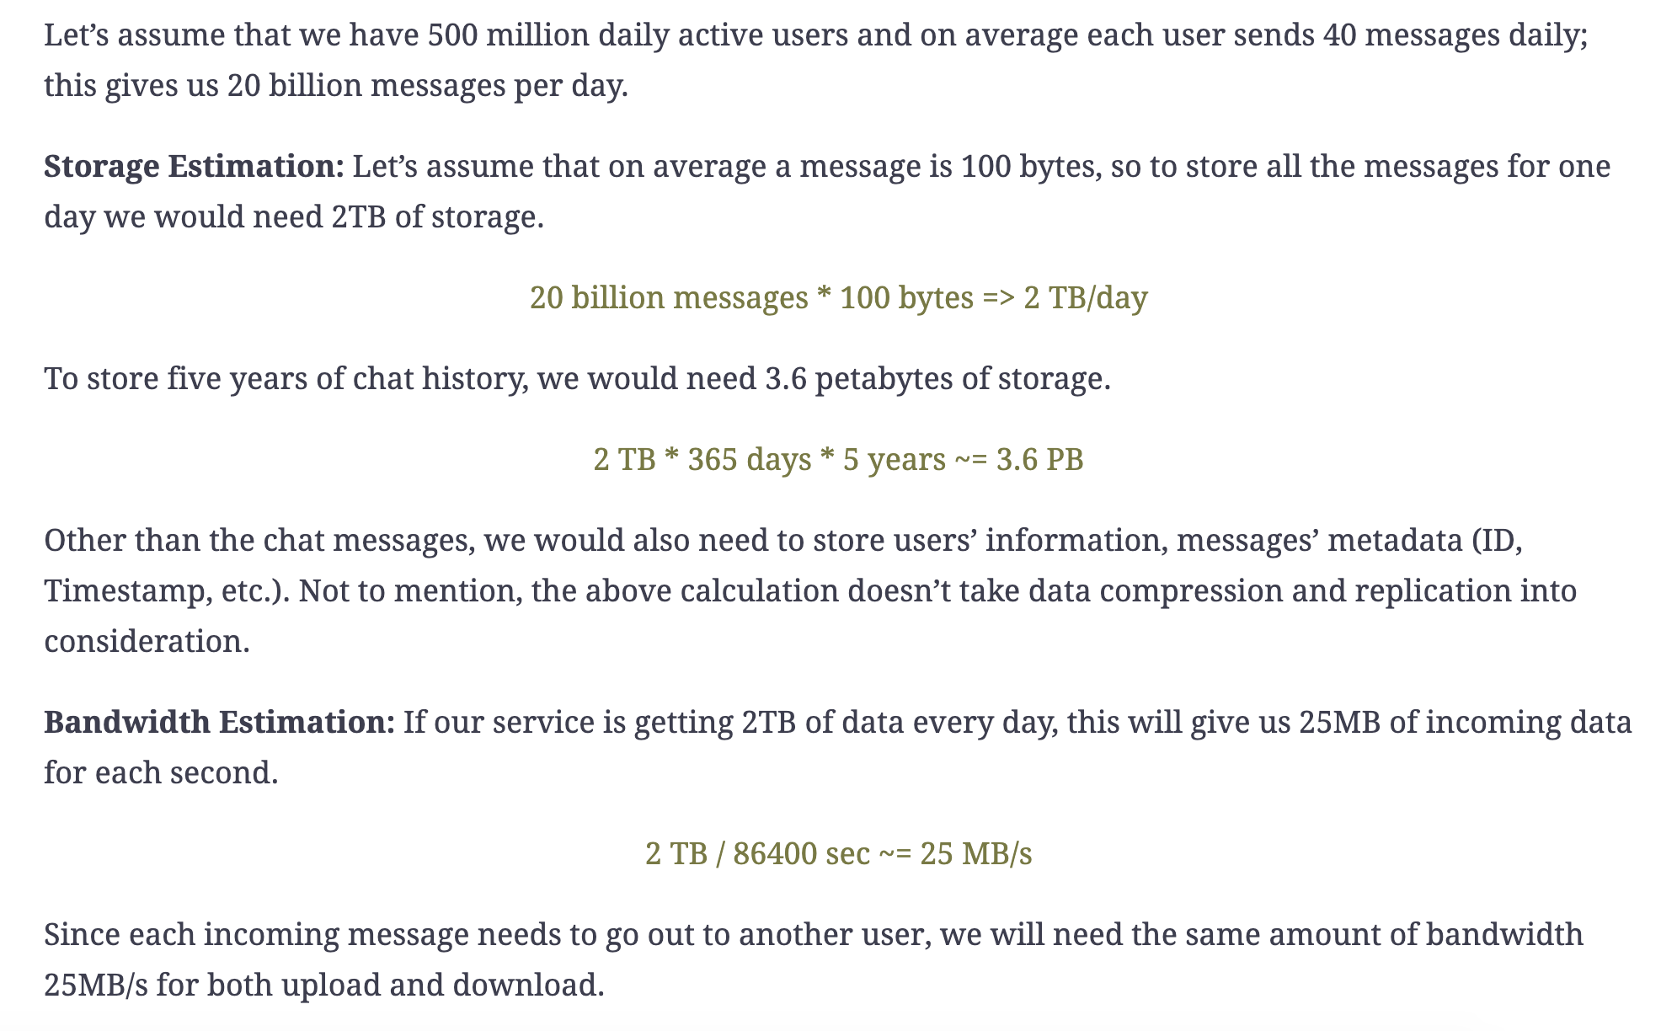
2. Scale of the system data size
Capacity Estimation and Constraints

Slide 6
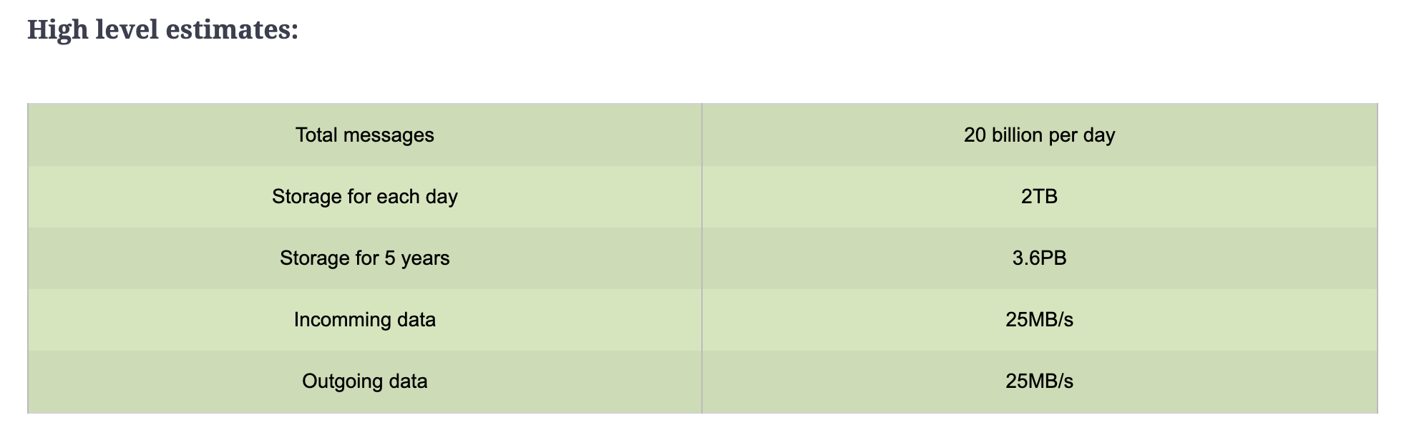
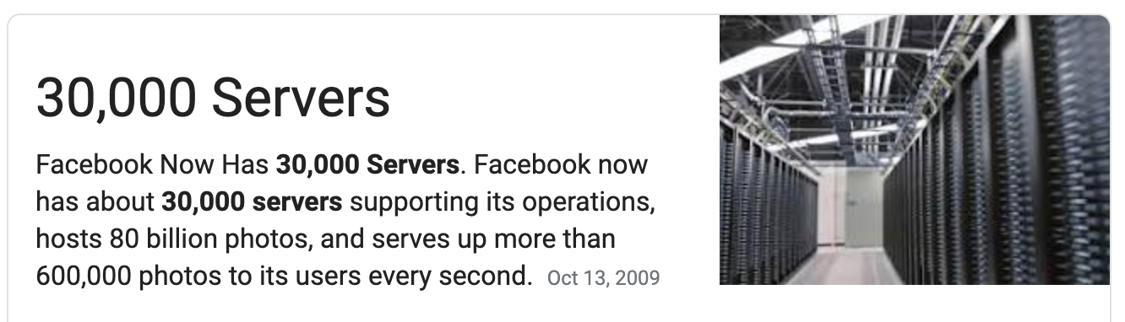
Real world ->

Slide 7
API interface design & Database model design
sendMessage(User from, User to, String message, Boolean userActivity)
isUserOnline(String userId)
User {
String userId;
TimeStamp time;
}
Message {
String messageId;
String content;
}

Slide 8
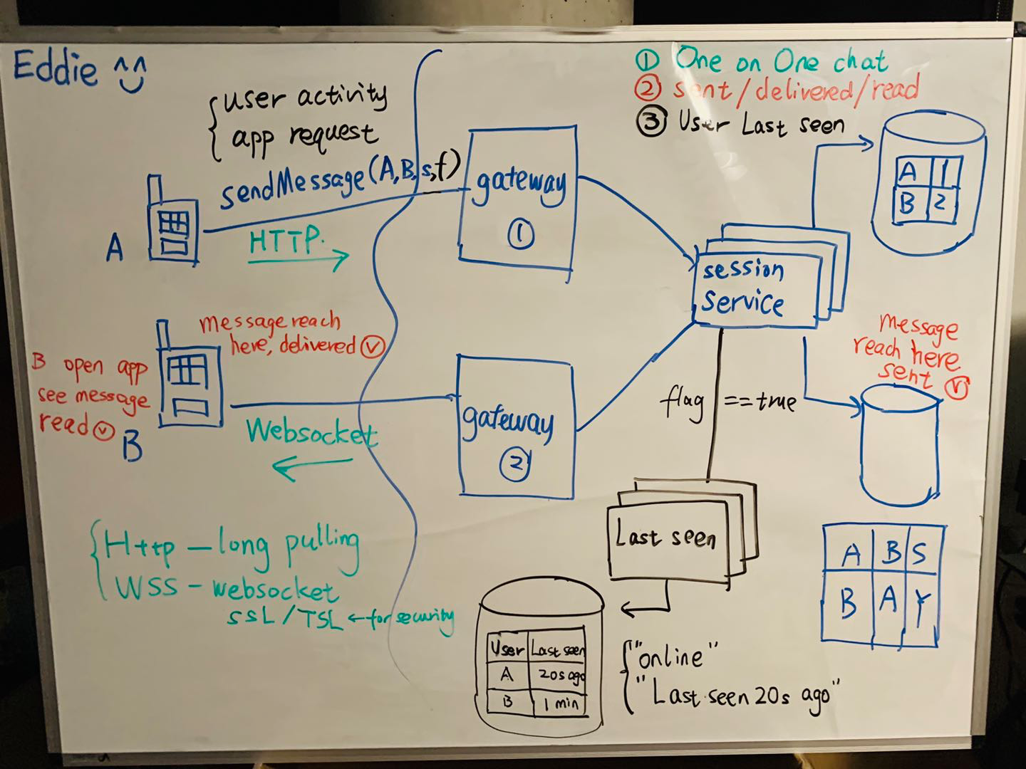
One to one chat
sent/delivered/read
User last login

Slide 9
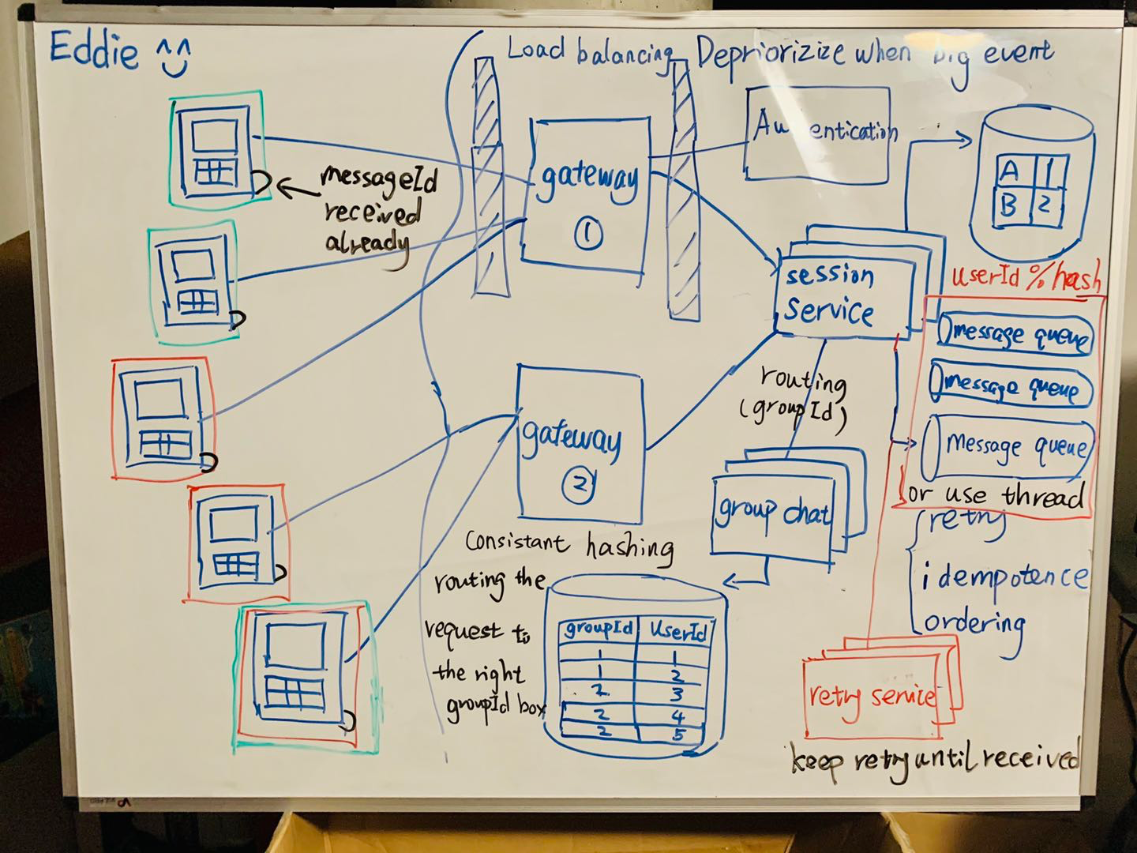
Group messaging
Delivery-retry
Idempotence
ordering

Slide 10
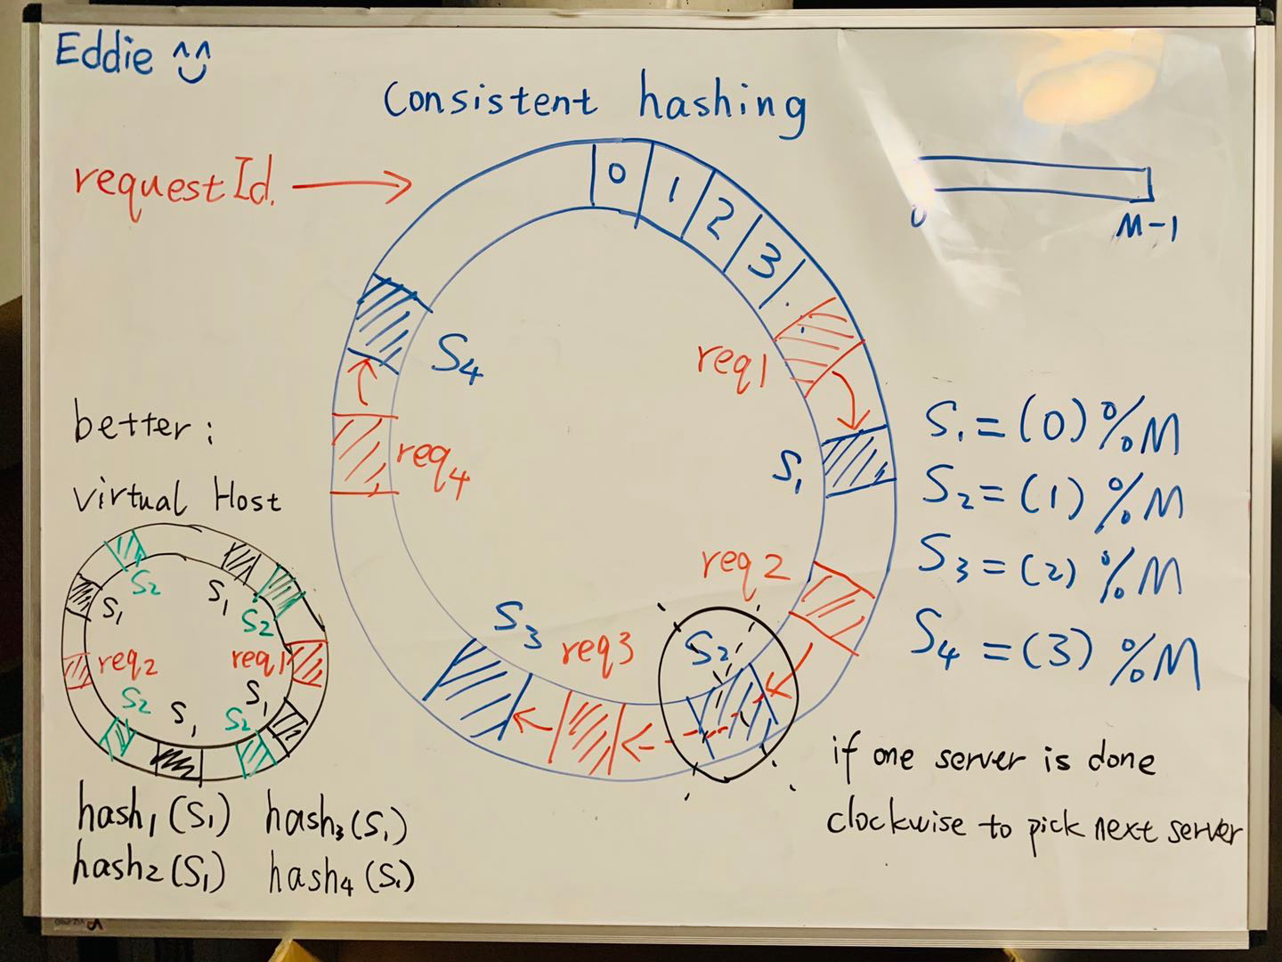
Consistent
hashing

Slide 11
Next?
System design - design youtube/netflix
Or
Algorithm - Dynamic Programming

Slide 12
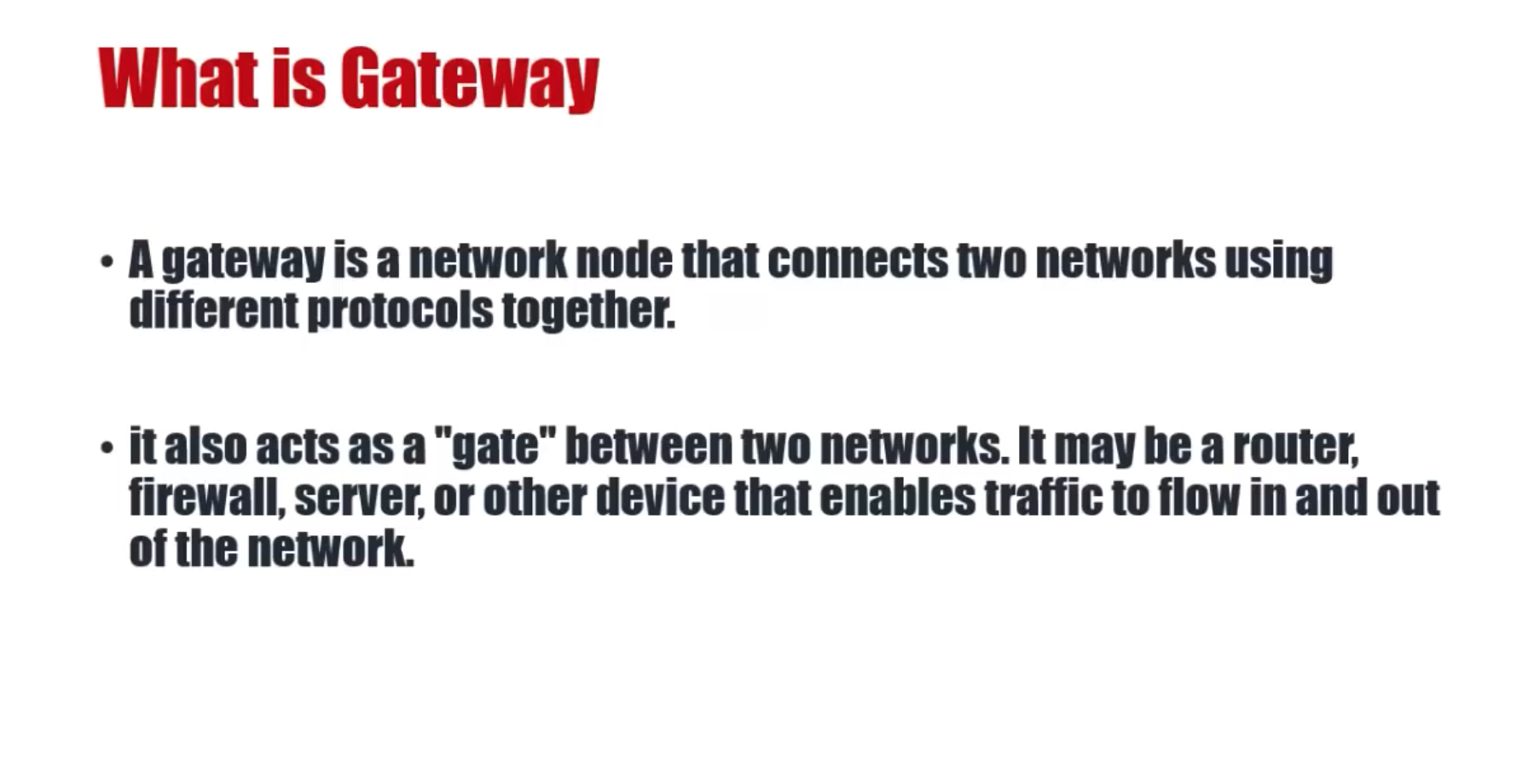

Slide 13
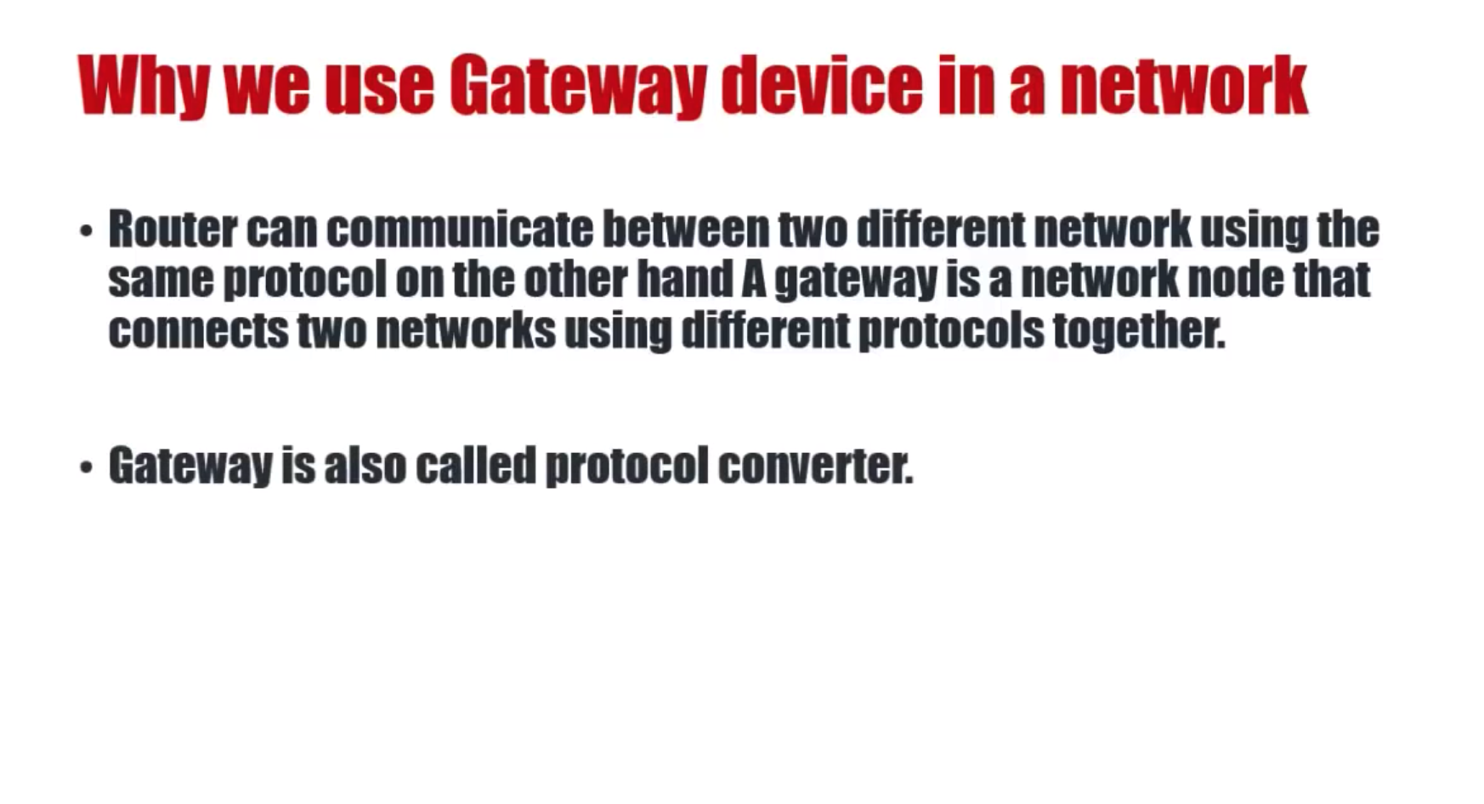

Slide 14
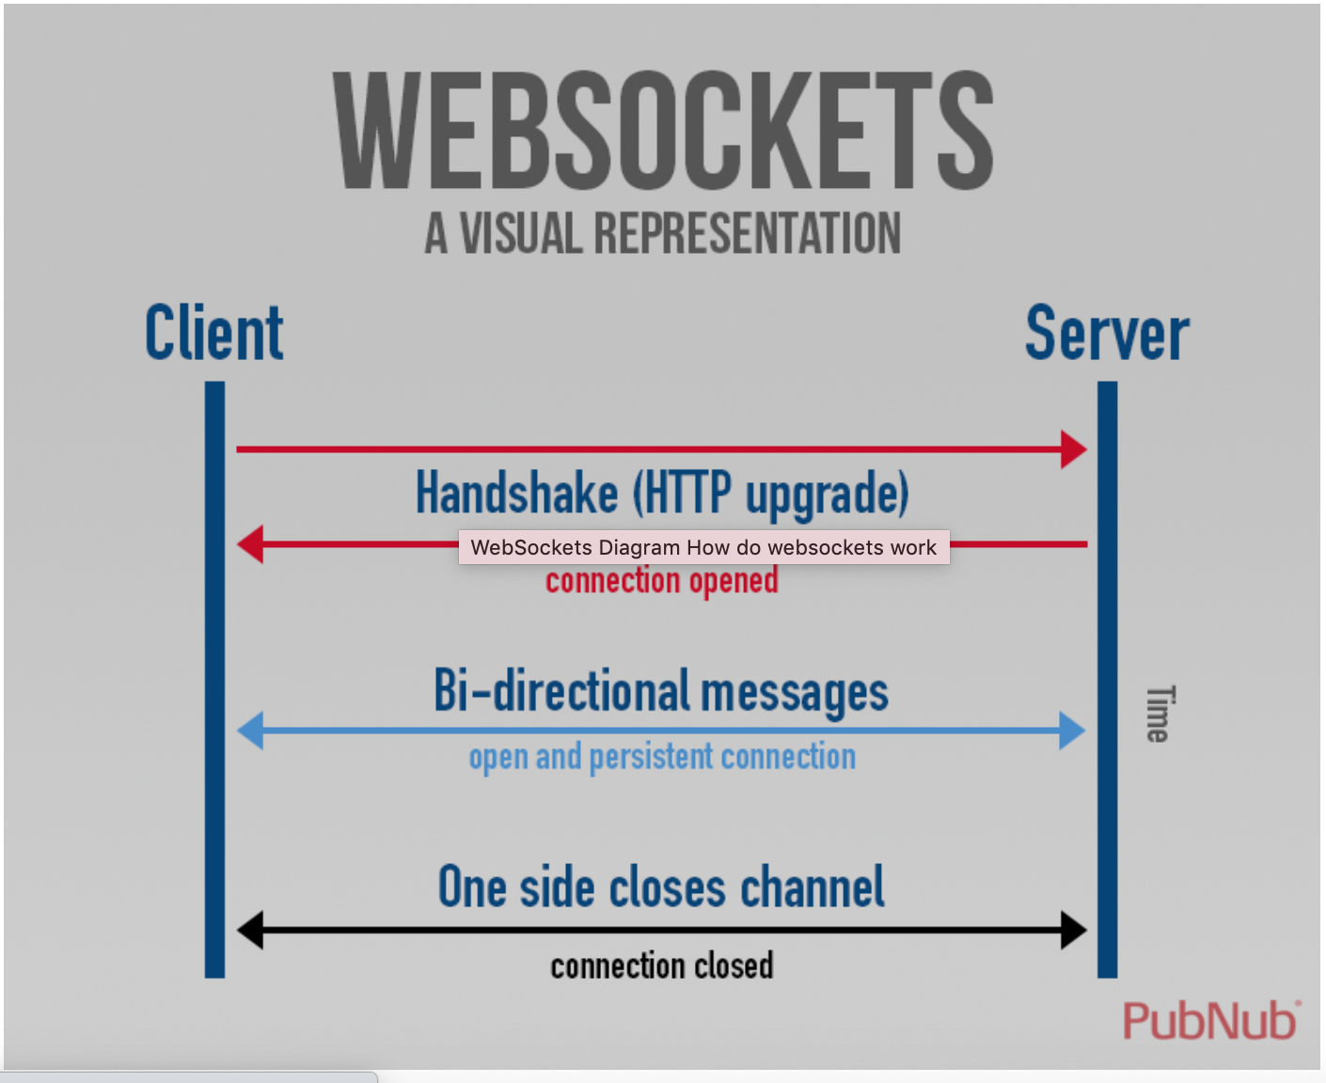
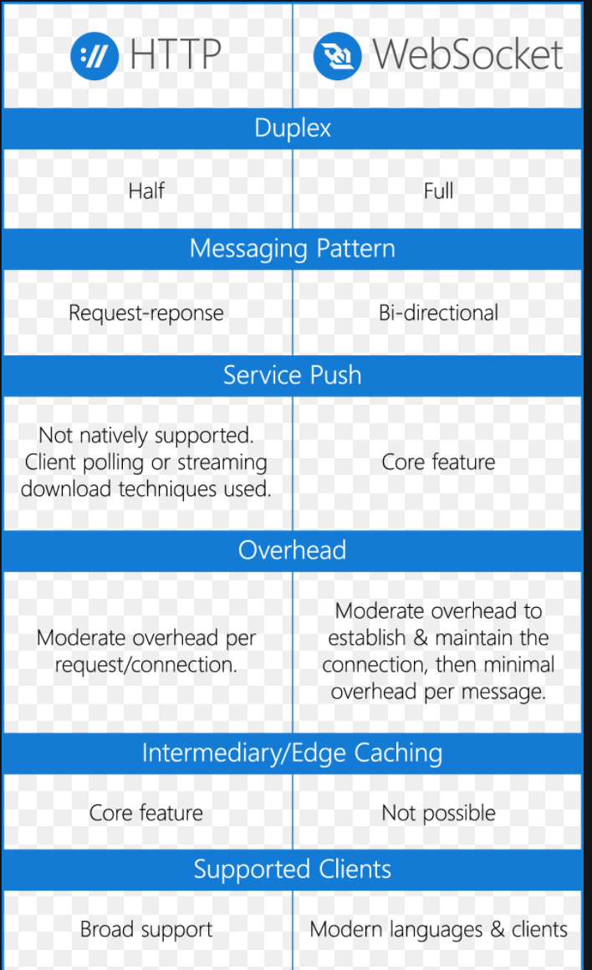

Slide 15
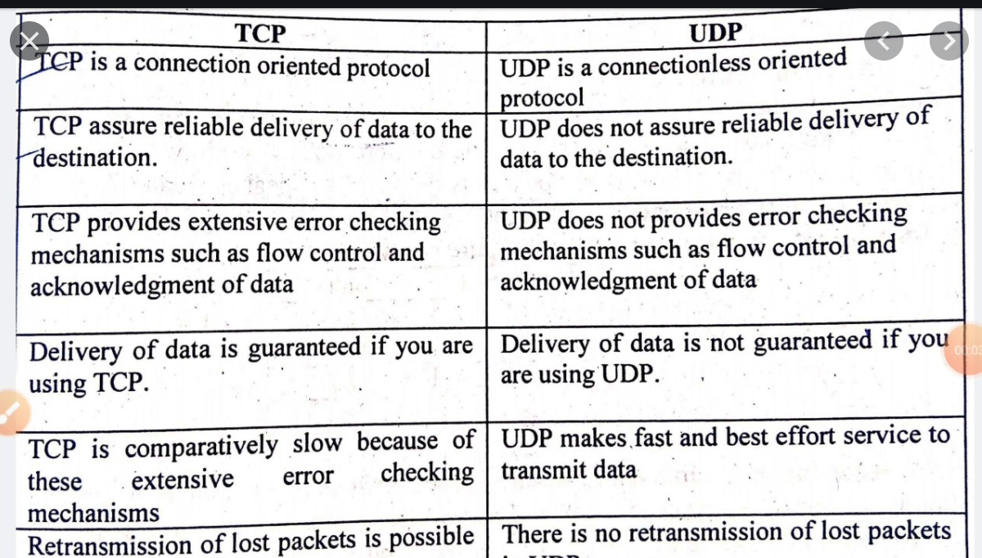

Slide 16
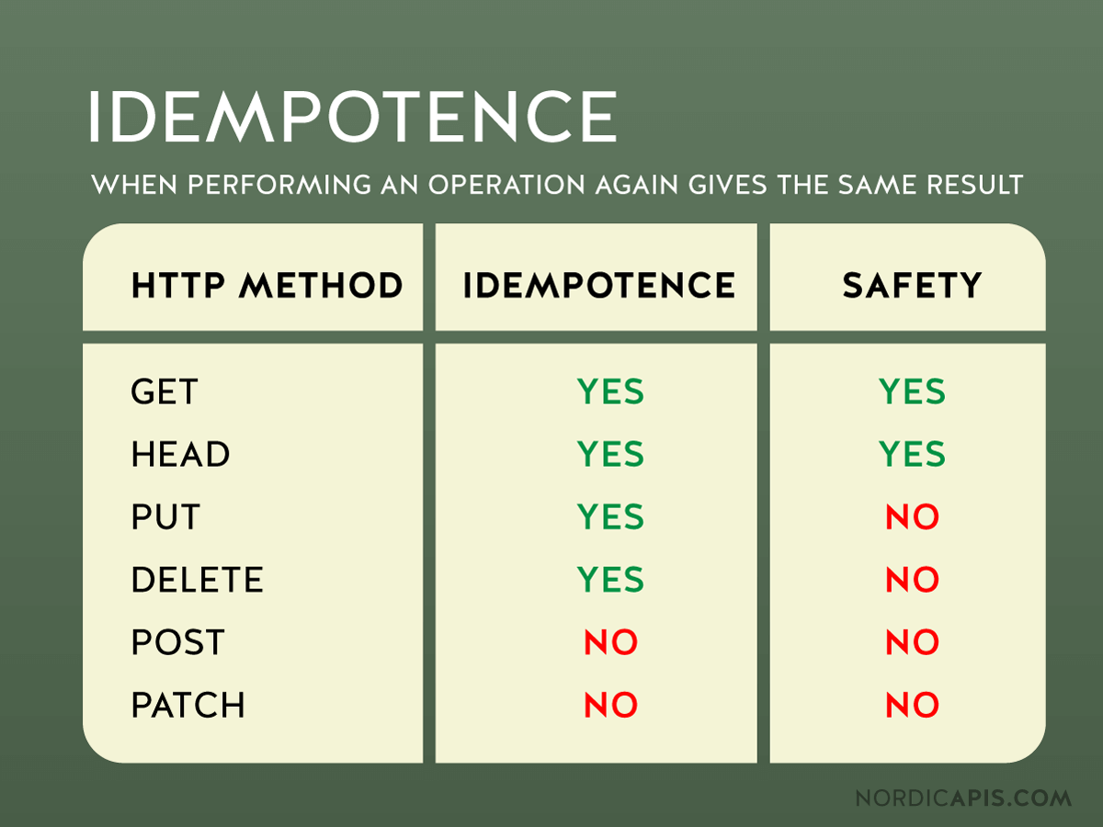
Idempotence
Idempotence is the property of certain operations in mathematics and computer science whereby they can be applied multiple times without changing the result beyond the initial application.

